Slide 1
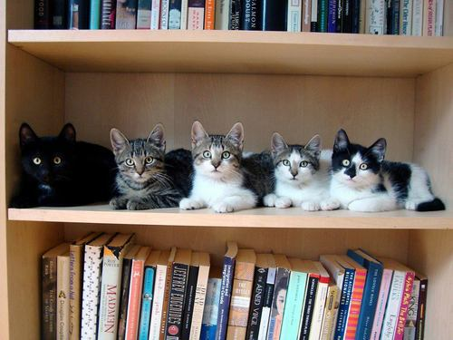
Library Privileges
Presenter: Jenna Jackson
Library Privileges Manager
Phone: (510) 643-6139
Privileges Desk Phone: (510) 642-3403
Email: jkjackso@library.berkeley.edu

Slide 2
How are library accounts created?
Human Capital Management (HCM): UCB staff, faculty, visiting scholars, and post docs all have records loaded from HCM into Millennium
Students: records loaded from the Office of the Registrar, based on current registration status
LBNL: automatically loaded into Millennium from LBNL HR records
Stanford: faculty and graduate students automatically loaded into Millennium with their Stanford ID barcode number

Slide 3
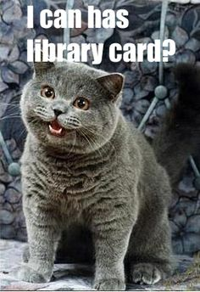
Blue Library Cards
Who gets them: members of UC Alumni Association that are California residents, California residents that purchase a library card for $100, UC Extension Students (not via Concurrent Enrollment-taking UC Berkeley classes)
Number of checkouts = 20
Not available = proxy access (except for UC Extension Students) or ILL

Slide 4
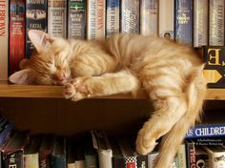
Yellow Library Cards
Who gets them: students, faculty, staff, visiting scholars, and post docs from other UCs; Graduate Theological Union (GTU) students and faculty; and spouses of UC Berkeley faculty and staff
Patrons with yellow cards generally have better library privileges than those with the blue card (ie. more checkouts).

Slide 5
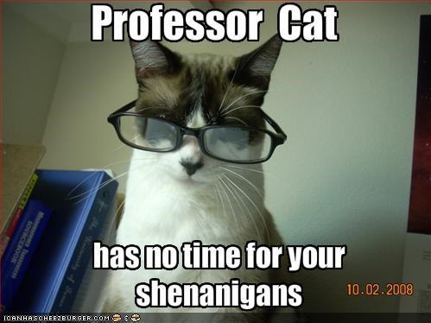
UC Berkeley Faculty Privileges
Fines do not block faculty library accounts.
Faculty accounts are only blocked if a recalled book is overdue and then only proxy server access is blocked, they can still check out library books.
Faculty do not accrue processing charges.
Maximum checkouts = 300

Slide 6
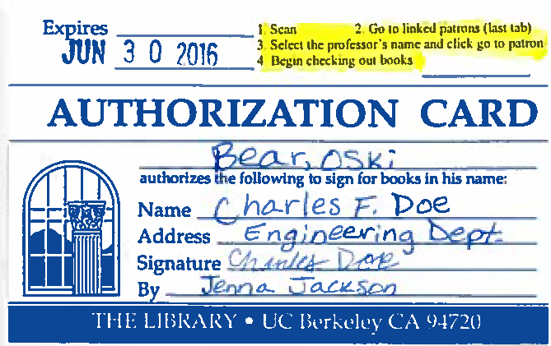
Proxy Card
Faculty and eligible DSP students can request a proxy user to be able to check out library materials on their behalf.
The proxy account is linked to the faculty or DSP student library account.
The faculty member or DSP student must submit the proxy request form online.
Instructions on how to check out materials to someone with a proxy card are highlighted on the front of the proxy card.
The proxy card holder does not have access to electronic resources or to make online requests.

Slide 7
UCB Student Privileges
Expiration date: the expiration date in UCB student library accounts is not the date their account will expire, it is a “dummy” date. Their accounts will expire when they are not listed as registered for the current semester.
Unregistered/filing fee students: students who are not registered for the current semester (excluding summer when most students are not registered) have their library accounts expired
Unregistered students who have not yet completed their degree and those on filing fee may submit a departmental letter on letterhead confirming that they are in good standing with their departments and are still working to complete their degree and pay a $25 fee to have their privileges extended for 6 months.

Slide 8
Graduated UCB Students
There is no grace period for library privileges, they can expire anytime after a student has graduated since they are no longer eligible.
Normally, May graduates retain privileges through the summer until the system sees that they are not registered for Fall classes.

Slide 9
UC Alumni
Paying members of the UC Alumni Association who are also California residents can get a UCB library borrowing card at no cost.
They must come in person to the Privileges Desk with their UC Alumni Association Membership Card and California photo ID to set up their library card.
Total # of checkouts = 20 at one time
Not available = proxy server or ILL services

Slide 10
UC Extension Students
UC Extension International Concurrent Enrollment Students obtain Cal1 ID Cards and the same library privileges as UC Berkeley students with no additional fees. Their accounts are automatically created in Millennium.
Other UC Extension Students can purchase a library card for $25 for a 6 month long library card (blue card).
Total # checkouts = 20 books at a time
Get proxy access but no ILL

Slide 11
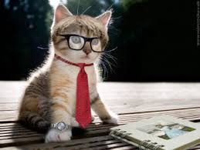
UC Extension Faculty/Staff
UC Extension faculty and staff records are automatically loaded into Millennium to create library accounts at UCB.
UC Extension faculty get similar privileges to UCB faculty (300 checkouts, proxy access, ILL privileges).
However, they do accrue processing charges and their accounts get blocked by fines.
UC Extension staff get the same library privileges as UCB staff (100 checkouts, ILL, and proxy access).

Slide 12
Graduate Theological Union (GTU)
GTU students can come to the Privileges Desk with their GTU student ID card (which has a semester registration sticker on it) to obtain a UC Berkeley Library Card at no cost.
GTU student checkouts = 200 at a time
GTU students and faculty not available = proxy access and ILL
GTU faculty can also get a free UCB Library Card with their GTU Faculty ID Card (must set up in person).
GTU faculty checkouts = 300 at a time
GTU Library Cards for students must be renewed in person each semester and annually for faculty.

Slide 13
LBNL Staff
Use their LBNL badge as their library card
Appointment records are loaded from LBNL records into Millennium.
Can login to Oskicat using their LBNL login
Most LBNL staff can check out up to 200 books at a time.
Must use LBNL proxy server-which does not have all the same resources as the UC Berkeley proxy server

Slide 14
Retirees
Must all come in person to the Privileges Desk to set up library privileges (except Emeritus who should have an ongoing appointment)
Must be CA residents to get library card
UC Berkeley Retirees: get same library privileges they had as current faculty or staff, including proxy access and ILL
Retirees from other UCs: no proxy access at UCB, only from home institution
LBNL/LLNL Retirees: no UCB proxy access, can check out up to 20 items at a time

Slide 15
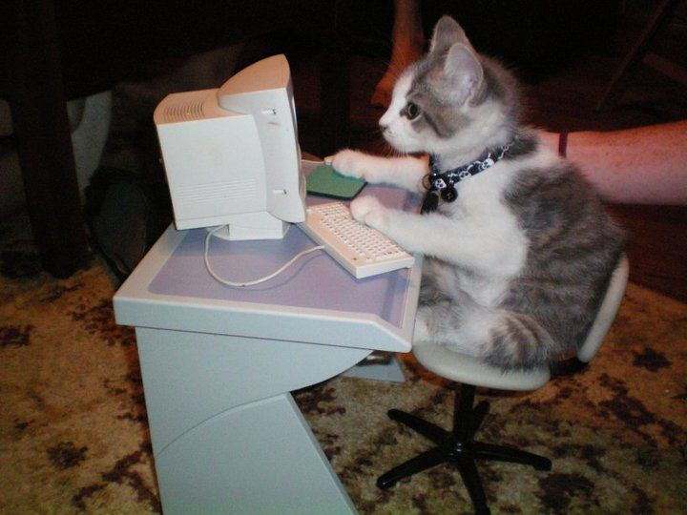
Proxy Server
Who gets access: current UCB faculty, staff, students, visiting scholars, post docs, UC Extension students with active library accounts, UC Extension faculty and staff, UC retirees with current library account etc.
Can use either calnet or patron/pin login to access
Must have proxy settings configured in browser

Slide 16
Billing
Electronic Devices for Students: fined $20 per hour overdue (up to replacement cost for the item)-no grace period for these items
The standard replacement cost for items is $150, but it can be higher if manually adjusted.
Replacement costs can be removed when a patron returns a billed item that has not yet been replaced by the library, but the $10 processing charge remains.
Patrons may supply replacement copies of items in lieu of paying the replacement cost, with approval from the owning unit.

Slide 17
Blocks
Registration Blocks: students obtain a registration block when they have library fines totaling $200 or more at one time, the block is not removed until the entirety of their library fines are paid, then the block is automatically removed overnight
Manual Blocks: overdue at IBS, no email, bounced email, library card lost
$50 or more in fines blocks everyone’s library account except for UCB faculty.

Slide 18
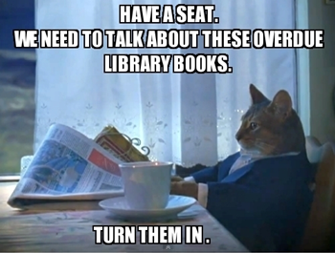
Waiving Fines
Each unit has the final say on fines from their unit.
Book replacement fees should never be waived per library administration.
Processing charges can be waived at the discretion of staff at the owning unit.
To reduce but not remove processing charges, the fine amount can be adjusted. This is a much better option than waiving as it is clearer in financial records.
Main does not waive any processing fees, unless it can be proved that they were accrued due to staff error (ie. for a billed claims returned book found in the stacks).
When waiving ALWAYS add a descriptive note as to why the fine was waived-”staff error” is not descriptive enough. We need to be able to account for why the money was waived and explain this if audited.

Slide 19
When to refer a patron to Privileges?
When patron is asking about: the expiration date of their account, how to renew their account, what their library privileges are, how to remove a block, how to pay/dispute fines, proxy server issues etc.

Slide 20
Online Resources
UC Berkeley Library website:
Borrowing
Renewing
Pay Fines
Library Privileges for Unregistered Students/Filing Fee
Graduate Students and GSI’s
Visiting Scholars and Post Docs
K-12 Teachers
Library Cards for Non UCB Patrons
Information for Alumni
Information for Faculty and Instructors
Information for Visitors
Proxy Server FAQ’s
AskTico:
Billing Broadsheet
Mark as Lost
Patron Codes
Patron Type
Patrons Who Have Proxy Server Access

Slide 21
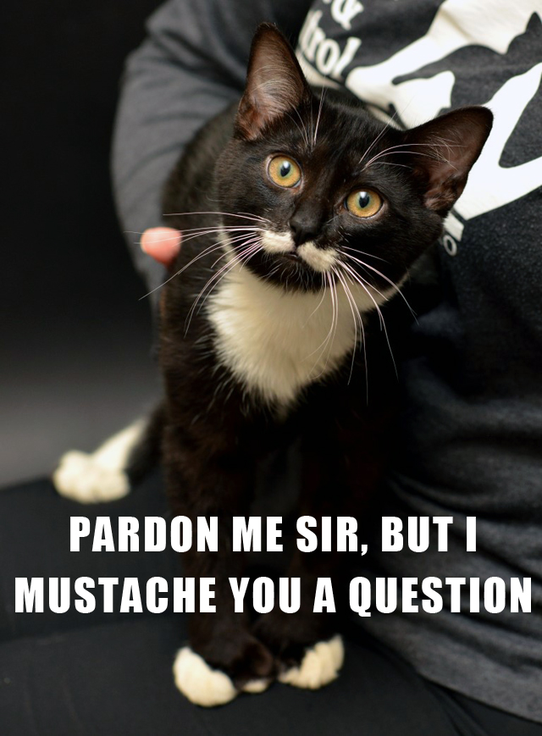
Questions

